Slide 1

Employee Data Analysis using Excel
STUDENT NAME: Mithilesh.A
REGISTER NO: 3122070113, unm130122b226
DEPARTMENT: B.com General
COLLEGE: Agurchand Manmull Jain

Slide 2

PROJECT TITLE
Employee Performance Analysis using Excel

Slide 3


AGENDA
Problem Statement
Project Overview
End Users
Our Solution and Proposition
Dataset Description
Modelling Approach
Results and Discussion
Conclusion
3/21/2024 Annual Review

Slide 4

PROBLEM STATEMENT
Performance analysis of employees is essential for optimizing resources, ensuring quality, aligning employee efforts with strategic goals, and making informed decisions. It helps improve job satisfaction, reduce turnover, and maintain legal compliance. Additionally, it supports continuous improvement, accountability, effective reward systems, and resource allocation, all of which contribute to the organization's long-term success and adaptability in a dynamic business environment.

Slide 5

PROJECT OVERVIEW
I’ve gathered performance-related data from various sources, including performance appraisals, KPIs, employee feedback, and peer reviews. Defined/refined the metrics and criteria that will be used to evaluate employee performance. And analyzed the collected data to identify patterns, trends, and areas of improvement at both individual and team levels, which would help in identifying training needs and develop personalized development plans for employees.

Slide 6
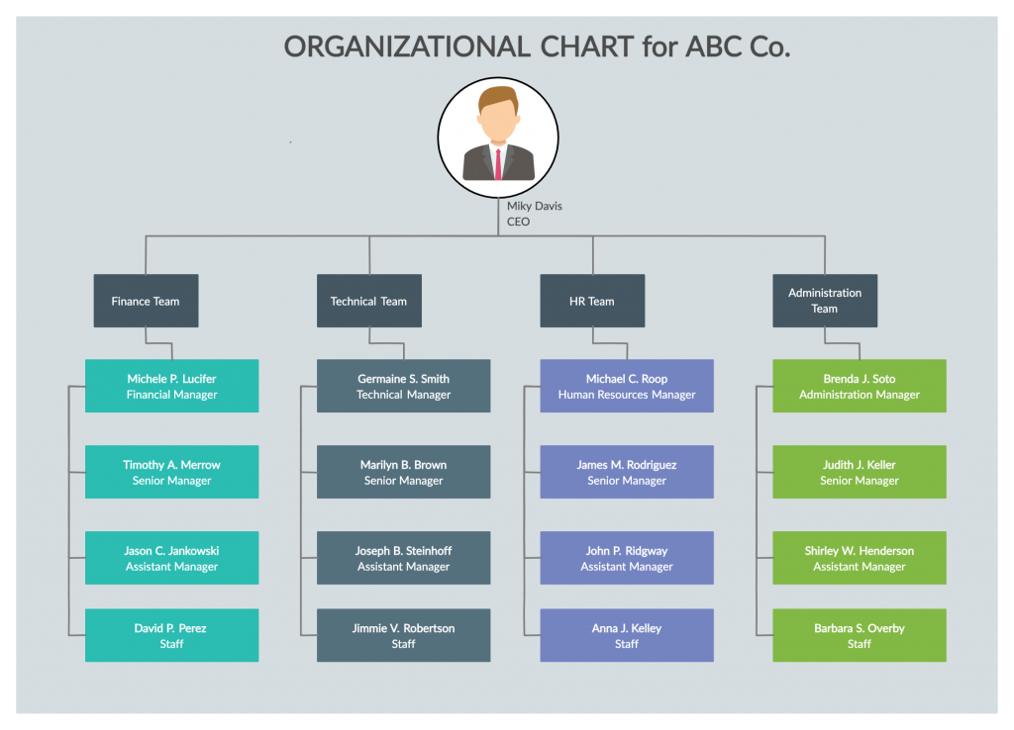

WHO ARE THE END USERS?

Slide 7

OUR SOLUTION AND ITS VALUE PROPOSITION
conditional formatting-missing
Filter-remove
Slicer
Formula-performance
Pivoting-summary
Graphical- visual representation

Slide 8
Dataset Description
employee data sheet=Kaggle
26 features
9- features used
Emp id-numerical
Name-text
Employee type
Employee performance
Gender-male, female
Employee rating-numerical

Slide 9

THE "WOW" IN OUR SOLUTION
Performance level=IFS(Z2>=5,"VERY HIGH",Z2>=4,"HIGH",Z2>=3,"MED","TRUE","LOW")
3/21/2024 Annual Review
9

Slide 10

MODELLING
Data collection
Edunet dash board
Defined and identified metrics
Features collections
Employee id
Employee name
Business unit
Employee type
Employee status
Employee classification type
Gender
Performance score
Current employee rating
10

Slide 11
Data cleaning
Identifying missing values
Clearing out missing values
Performance level
Calculated using the following formula: =IFS(Z2>=5,"VERY HIGH",Z2>=4,"HIGH",Z2>=3,"MED","TRUE","LOW")
Applied the above mentioned formula on current employee rating
Summary
Pivot table analysis
Business units as rows
Gender as filter
Performance level as columns
Name as value
Filtered the data
Sliced the data with reference to employee type

Slide 12
Visualization
Drafted the summary of my analysis using a chart
Filters involved:
Business unit, performance level, count of first name and gender
Chart elements used: Axis, chart title, data labels, grid lines, legend, trend lines

Slide 13
RESULTS
13

Slide 16
conclusion
The performance analysis reveals a workforce distribution where medium-level performers constitute the majority, followed by high performers, low performers, and a small group of very high performers. Specifically:
Medium-Level Performers: This group represents the largest portion of our employees. These individuals consistently meet job expectations and contribute reliably to the organization. While their performance is solid, there is potential for further growth and development.
High Performers: A significant number of employees fall into this category. These individuals exceed expectations regularly, take initiative, and are key contributors to the organization’s success.
Low Performers: A smaller segment of employees are currently not meeting performance standards. This group may benefit from additional training, support, or reassignment to roles that better match their skills.

Slide 17
Very High Performers: The smallest group in the analysis, these employees consistently deliver outstanding results, demonstrating exceptional skills, leadership, and a significant impact on the organization.

